Slide 1
Milestone 1
Phase II
Progress Review
Shivashankar S 4MH15CS085
N Nithin Srivatsav 4MH16CS056
Ponnanna MB 4MH16CS071
Swathi N Shayana 4MH16CS106
Guide: Prof. Kavya Priya M L

Slide 2
Introduction
Motivation
Problems farmers are facing currently :
Poor overview of the entire farming procedure.
Abuse of modern farming methods.
Half-knowledge on usage of fertilizers.
Damaging land due to over usage of soil.
Hardships in deciding prices.
Economy
Farmers
Debts
Poor soil
Uninformed Decisions
Unethical Pricing
Traditional methods
Entire Nation
High level Production
Local Vendors
Farmers
Uninformed
Decisions
Poor Overview of Soil

Slide 3
Existing systems
Present
Not Present
Recommends crop.
Recommends fertilizer.
Uses short range IoT.
Individual projects.
Poor feature selection for price prediction.
Random classification algorithms.
Long range IoT.

Slide 4
Proposed System
Data
Feature selection
Algorithm
Train
Accuracy
Highly iterative process.
State-of-the-art IoT technology.
Dashboard for real time display of data.
Voice assistant integration.

Slide 5
Objectives
Recommend Crop to be planted.
Recommend Fertilizer to be used.
Voice assistant based irrigation system.
Give real time data of soil to farmer.
Base line for price.

Slide 6
Methodology -
Machine/Deep Learning
Model building and accuracy check.
Data preprocessing and cleaning
Change parameters and tune the model

Slide 7
Methodology -
IoT
01
Choose componentes
Integrate
Testing
03
02
PCB

Slide 8
Work Progress
IoT architecture completed.
EDA on data done and some models built.
Crop recommendation objective achieved.
Web Interface in progress (Home and Login page completed).

Slide 9
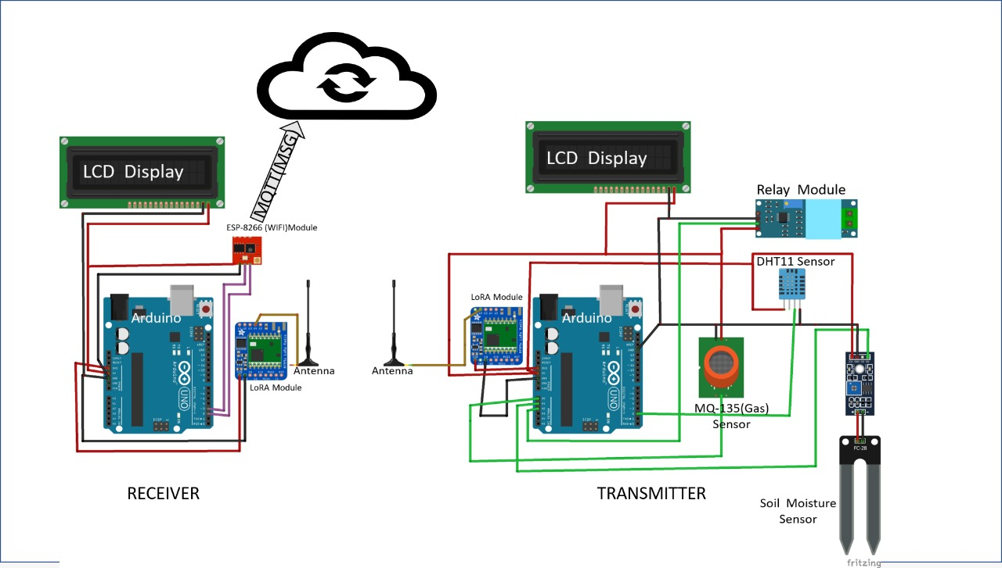
Circuit diagram for receiver and transmitter

Slide 10
Components used in receiver and transmitter
LoRa (Long Range) Module.
ESP-8266 Wi-Fi Module.
Arduino ATMEGA 328 Microcontroller.
DHT 11 – Temperature and Humidity Sensor.
FC 28 - Soil Moisture Sensor.
MQ 135 – Gas Sensor.

Slide 11
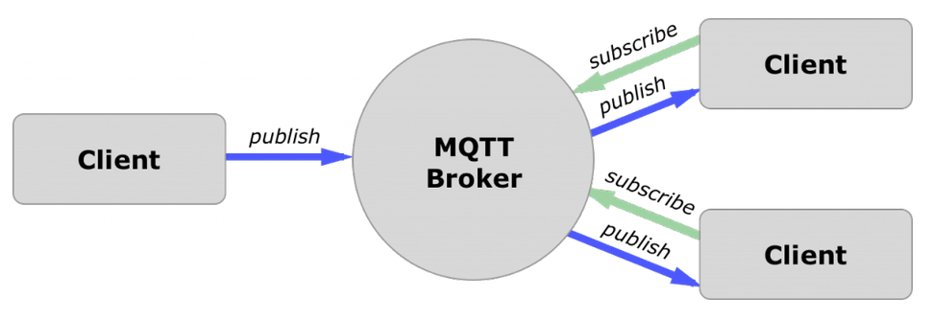
IoT protocol used
MQTT Protocol
Why MQTT?
It’s a lightweight protocol.
Easy to implement in software and fast in data transmission.
Minimized data packets. Hence, low network usage.
Low power usage. As a result, it saves the connected device’s battery.
It’s real time. Hence perfect for IoT applications.

Slide 12
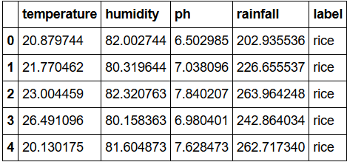
Crop Recommendation Module
Data was retrieved from Kaggle, data.gov.in etc.,
Dataset used:
15,500 bytes of data with 3100 rows.
No. of target variables = 30.
8:2 Train -Test split.

Slide 13
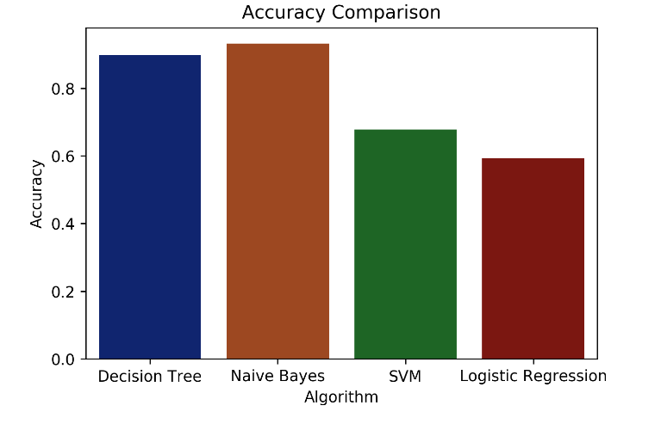
Decision Tree: 90% Naïve Bayes: 93%
SVM: 63% Logistic Regression: 57%

Slide 14
Future Roadmap
Build more models and test.
Complete fertilizer recommendation objective.
Build voice assistant based irrigation system.
Integrate the IoT components with the web interface.
Web dashboard completion.
Write APIs to fetch data.

Slide 15
Thank You

